Slide 1


Lecture 5
Produced by Dr. Worldwide
Welcome to the 305
~
~

Slide 2


Sensitivity Analysis
A sensitivity analysis is how we investigate the effect changes in the objective function and constraints have on the optimal solution
Types of changes
Changes in the objective function coefficients
Changes in the constraint quantity values
Changes in the constraint coefficients
Additional constraints
Additional decision variables
Excel’s Solver can handle changes in the first two types
Other types involve rerunning Excel’s Solver with different information

Slide 3
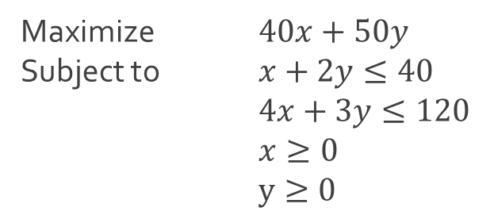
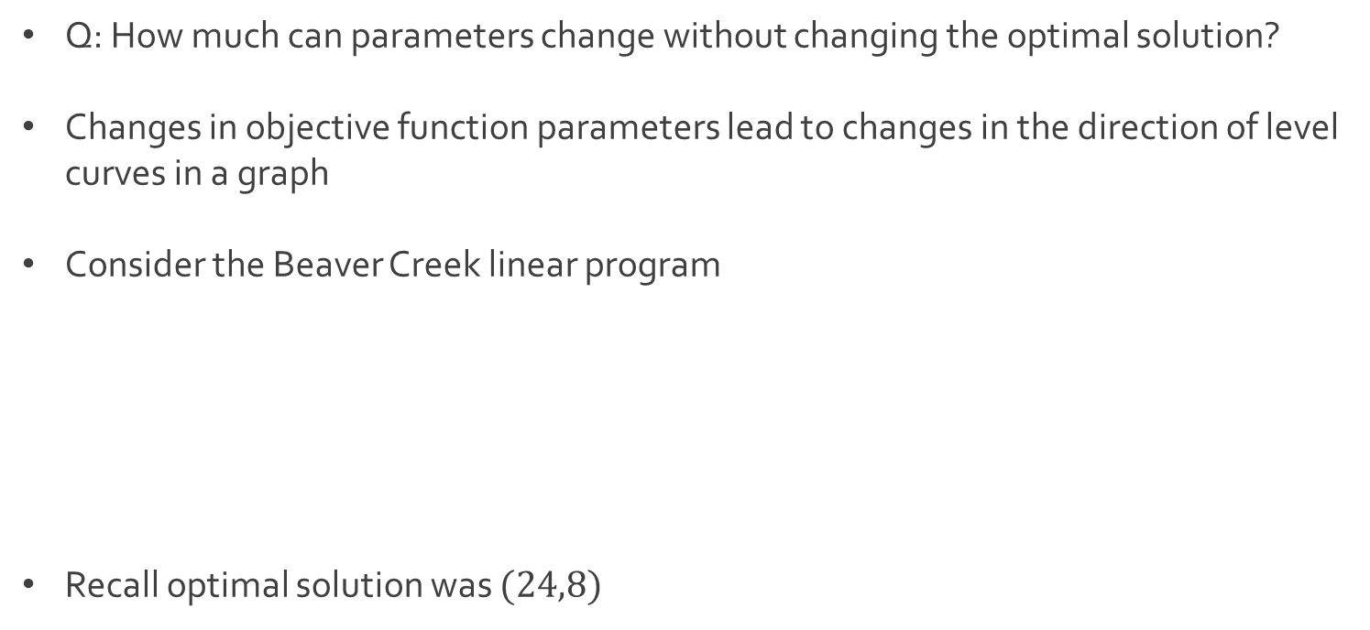
Changing Objective Function
Q: How much can parameters change without changing the optimal solution?
Changes in objective function parameters lead to changes in the direction of level curves in a graph
Consider the Beaver Creek linear program
Recall optimal solution was $(24,8)$
Maximize $40x+50y$
Subject to $x+2y≤40$
$4x+3y≤120$
$x≥0$
$y≥0$

Slide 4
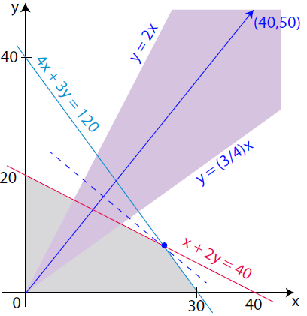

Changing Objective Function
We will “tilt” the objective function coefficients $\left(a,b\right)=(40,50)$ until the optimal solution changes
Any vector in direction of $\left(a,b\right)$, where $\left(a,b\right)$ is in the purple region will lead to the same optimal solution

Slide 5
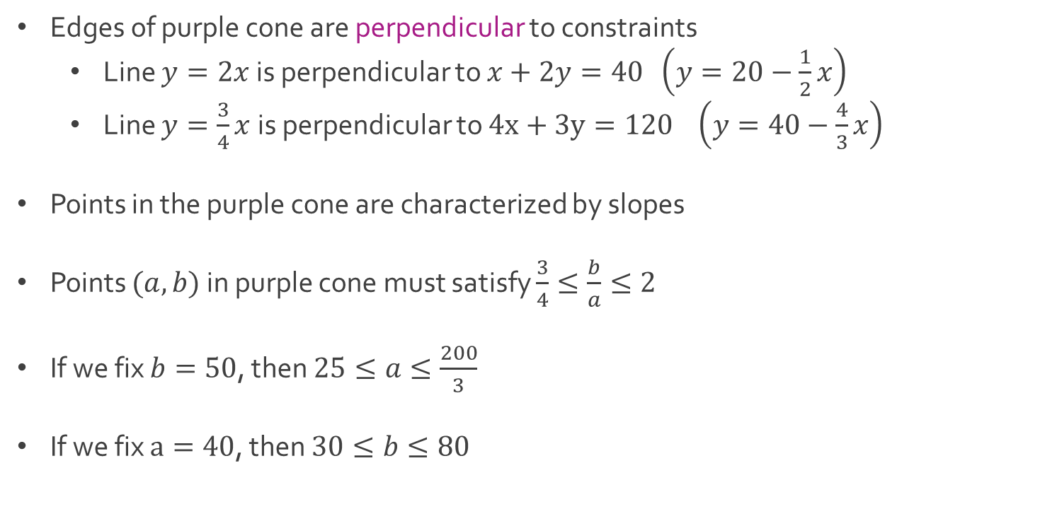
Changing Objective Function
Edges of purple cone are perpendicular to constraints
Line $y=2x$ is perpendicular to $x+2y=40 \left(y=20−\frac{1}{2}x\right)$
Line $y=\frac{3}{4}x$ is perpendicular to $4x+3y=120 \left(y=40−\frac{4}{3}x\right)$
Points in the purple cone are characterized by slopes
Points $(a,b)$ in purple cone must satisfy $\frac{3}{4}≤\frac{b}{a}≤2$
If we fix $b=50$, then $25≤a≤\frac{200}{3}$
If we fix $a=40$, then $30≤b≤80$

Slide 6
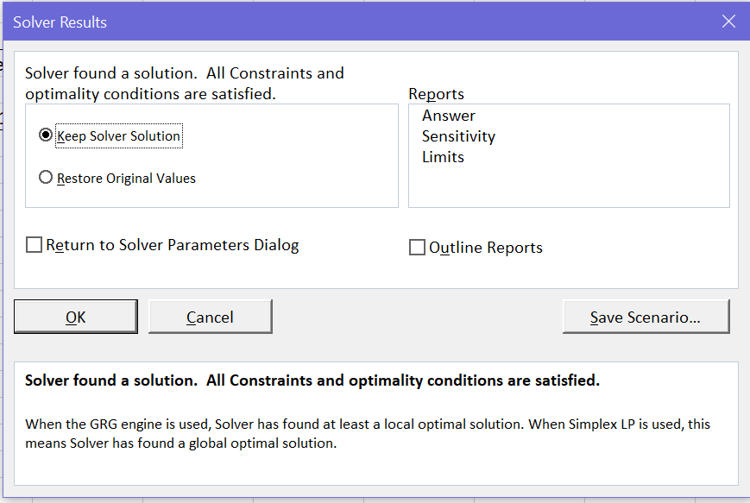
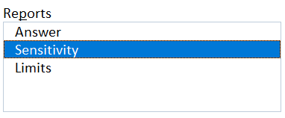

Ex: Beaver Creek Pottery
Download BeaverCreek.xlsx from website link called Sheet 1
We start by considering changes to the objective function $40x+50y$
Attempt to solve linear program produces menu of options
Selecting OK creates a new sheet in Excel file
Select Sensitivity

Slide 7
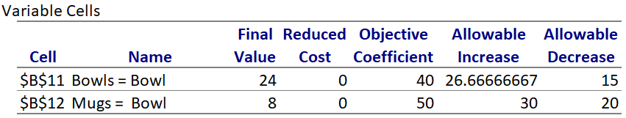

Ex: Beaver Creek Pottery
Sensitivity analysis for objective function displayed below
If we fix $b=50$, then $25=40−15≤a≤40+26.67=\frac{200}{3}$
If we fix $a=40$, then $30=50−20≤b≤50+30=80$
Next, we consider changes to the constraint quantit

Slide 8

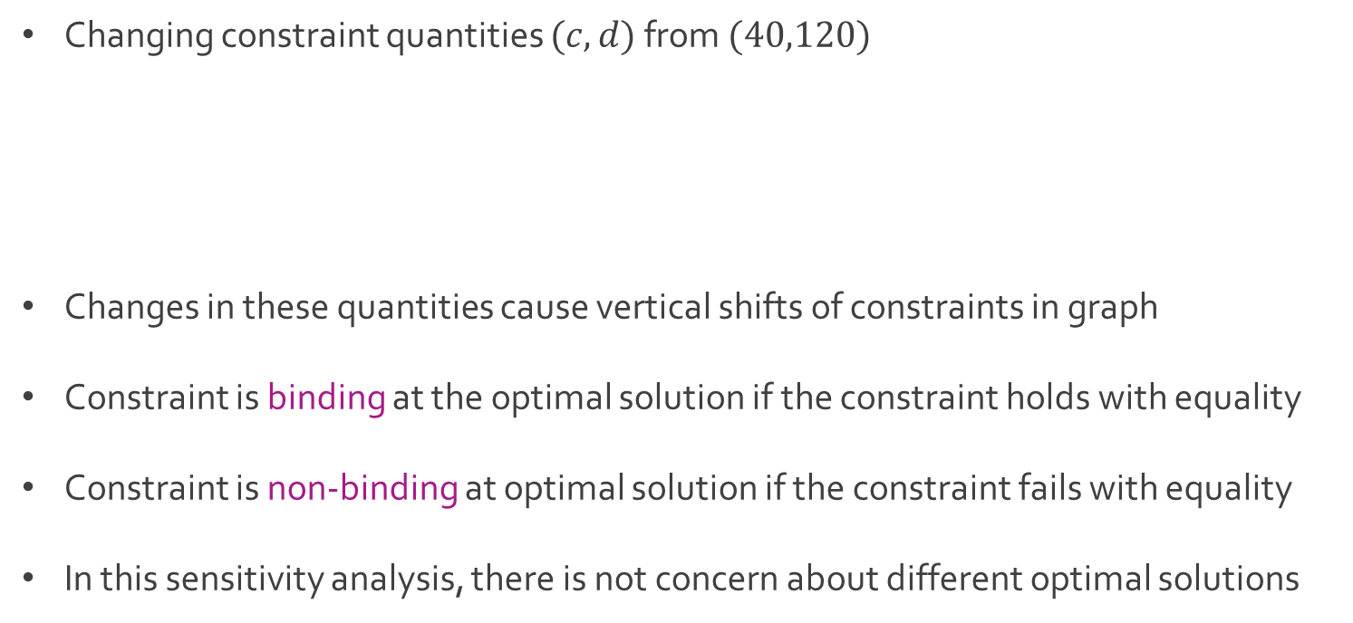
Changing Constraint Quantity
Changing constraint quantities $(c,d)$ from $(40,120)$
Changes in these quantities cause vertical shifts of constraints in graph
Constraint is binding at the optimal solution if the constraint holds with equality
Constraint is non-binding at optimal solution if the constraint fails with equality
In this sensitivity analysis, there is not concern about different optimal solutions
Subject to $x+2y≤c$
$4x+3y≤d$
$x≥0$
$y≥0$

Slide 9
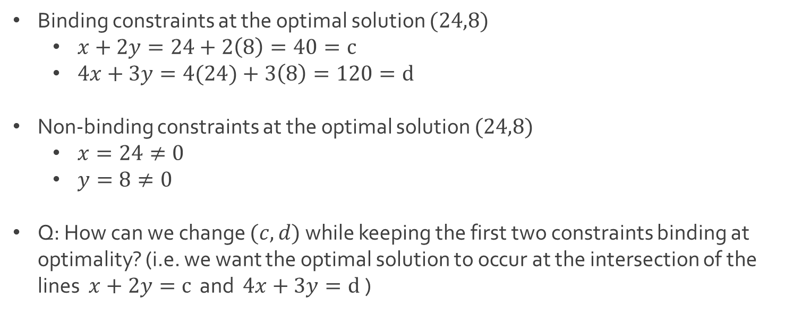
Changing Constraint Quantity
Binding constraints at the optimal solution $(24,8)$
$x+2y=24+2\left(8\right)=40=c$
$4x+3y=4(24)+3\left(8\right)=120=d$
Non-binding constraints at the optimal solution $(24,8)$
$x=24≠0$
$y=8≠0$
Q: How can we change $(c,d)$ while keeping the first two constraints binding at optimality? (i.e. we want the optimal solution to occur at the intersection of the lines $x+2y=c$ and $4x+3y=d$)

Slide 10
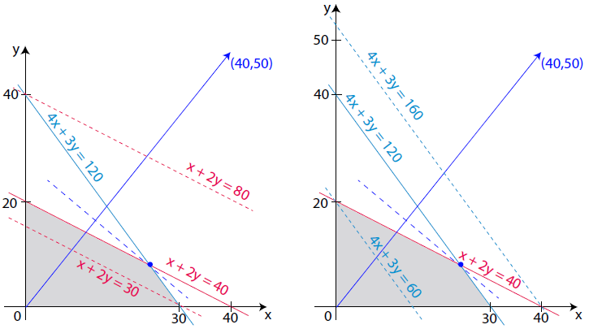

Changing Constraint Quantity
Adjustment of y-intercepts of lines until lines don’t intersect and one of the constraints is no longer “necessary”
We can change $30≤c≤80$ and $60≤d≤160$

Slide 11
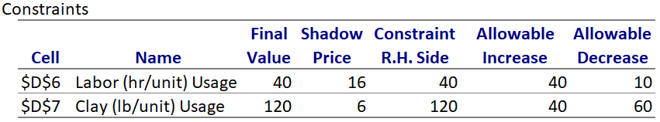
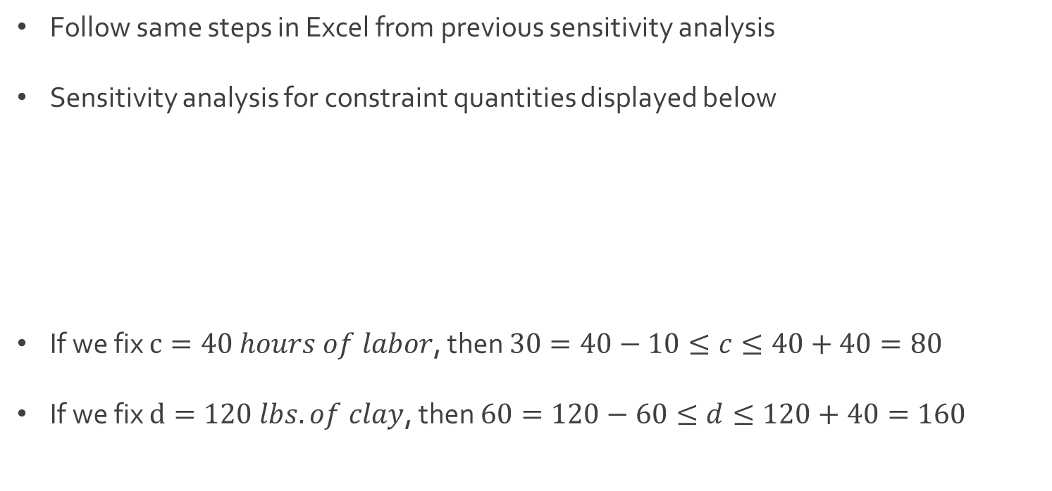
Ex: Beaver Creek Pottery
Follow same steps in Excel from previous sensitivity analysis
Sensitivity analysis for constraint quantities displayed below
If we fix $c=40 hours of labor$, then $30=40−10≤c≤40+40=80$
If we fix $d=120 lbs. of clay$, then $60=120−60≤d≤120+40=160$

Slide 12
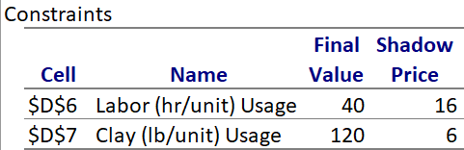
Shadow Prices
The shadow price or dual value of a constraint (resource) correspond to the maximum amount that one would be willing to pay for one additional unit of that resource
Standard sensitivity reports include these shadow prices
In general, there is one shadow price for each constraint

Slide 13
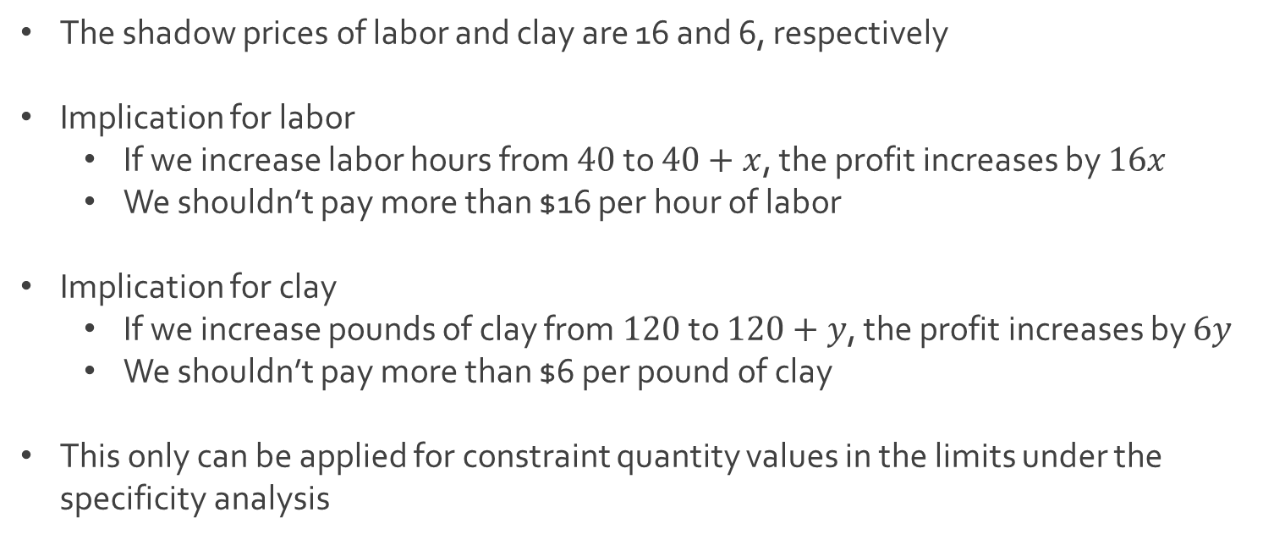
Ex: Beaver Creek Pottery
The shadow prices of labor and clay are 16 and 6, respectively
Implication for labor
If we increase labor hours from $40$ to $40+x$, the profit increases by $16x$
We shouldn’t pay more than $16 per hour of labor
Implication for clay
If we increase pounds of clay from $120$ to $120+y$, the profit increases by $6y$
We shouldn’t pay more than $6 per pound of clay
This only can be applied for constraint quantity values in the limits under the specificity analysis

Slide 14
Ex: Quick-Screen Clothing
Quick-Screen is a clothing manufacturing company specializing in the production of commemorative shirts immediately following major sporting events and they have a contract to produce shirts for winning team of a college football bowl game on New Year’s Day between State and Tech
They will produce two different sweatshirts and two different t-shirts with one of each having writing on front (F) only and the other having writing on both front (F) and back (B)
All items will be produced by the box where each box contains a dozen items
Q: How much of each of the items should be produced to maximize profit?

Slide 15
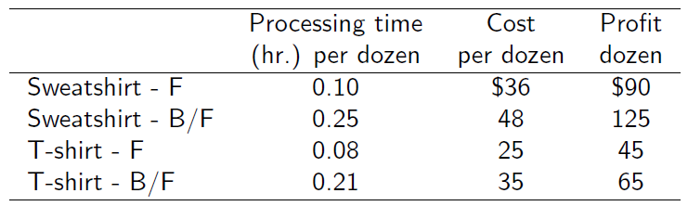
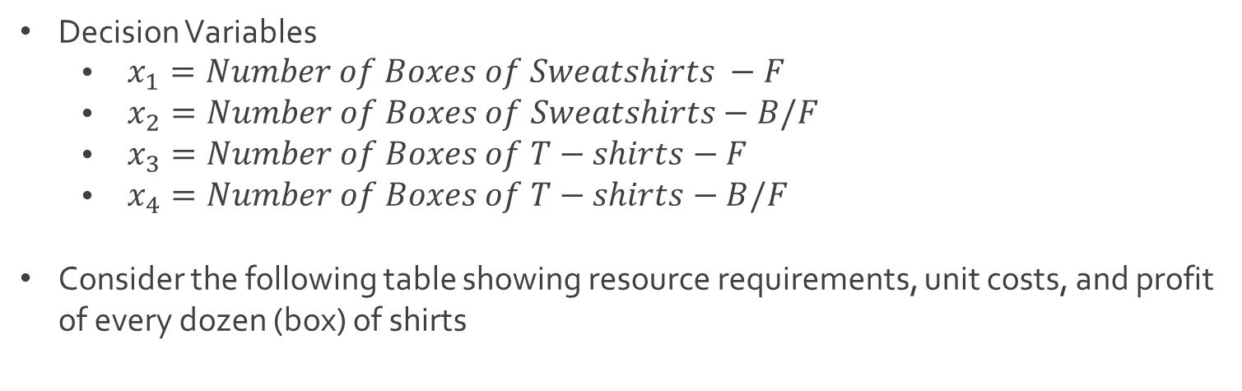
Ex: Quick-Screen Clothing
Decision Variables
$\begin{aligned} x_{1}=Number of Boxes of Sweatshirts −F\end{aligned}$
$\begin{aligned} x_{2}=Number of Boxes of Sweatshirts−\#B/F\end{aligned}$
$\begin{aligned} x_{3}=Number of Boxes of T−shirts−F\end{aligned}$
$\begin{aligned} x_{4}=Number of Boxes of T−shirts−B/F\end{aligned}$
Consider the following table showing resource requirements, unit costs, and profit of every dozen (box) of shirts

Slide 16
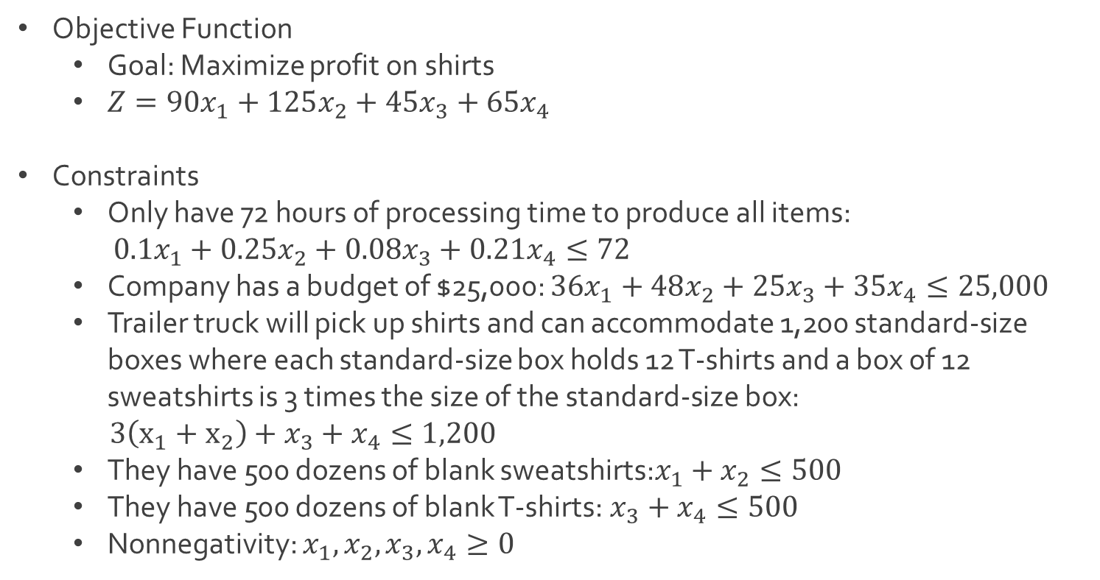
Ex: Quick-Screen Clothing
Objective Function
Goal: Maximize profit on shirts
$Z=90x_{1}+125x_{2}+45x_{3}+65x_{4}$
Constraints
Only have 72 hours of processing time to produce all items:
$0.1x_{1}+0.25x_{2}+0.08x_{3}+0.21x_{4}≤72$
Company has a budget of $25,000: $36x_{1}+48x_{2}+25x_{3}+35x_{4}≤25,000$
Trailer truck will pick up shirts and can accommodate 1,200 standard-size boxes where each standard-size box holds 12 T-shirts and a box of 12 sweatshirts is 3 times the size of the standard-size box:
$3\left(x_{1}+x_{2}\right)+x_{3}+x_{4}≤1,200$
They have 500 dozens of blank sweatshirts:$x_{1}+x_{2}≤500$
They have 500 dozens of blank T-shirts:$x_{3}+x_{4}≤500$
Nonnegativity: $x_{1},x_{2},x_{3},x_{4}≥0$

Slide 17
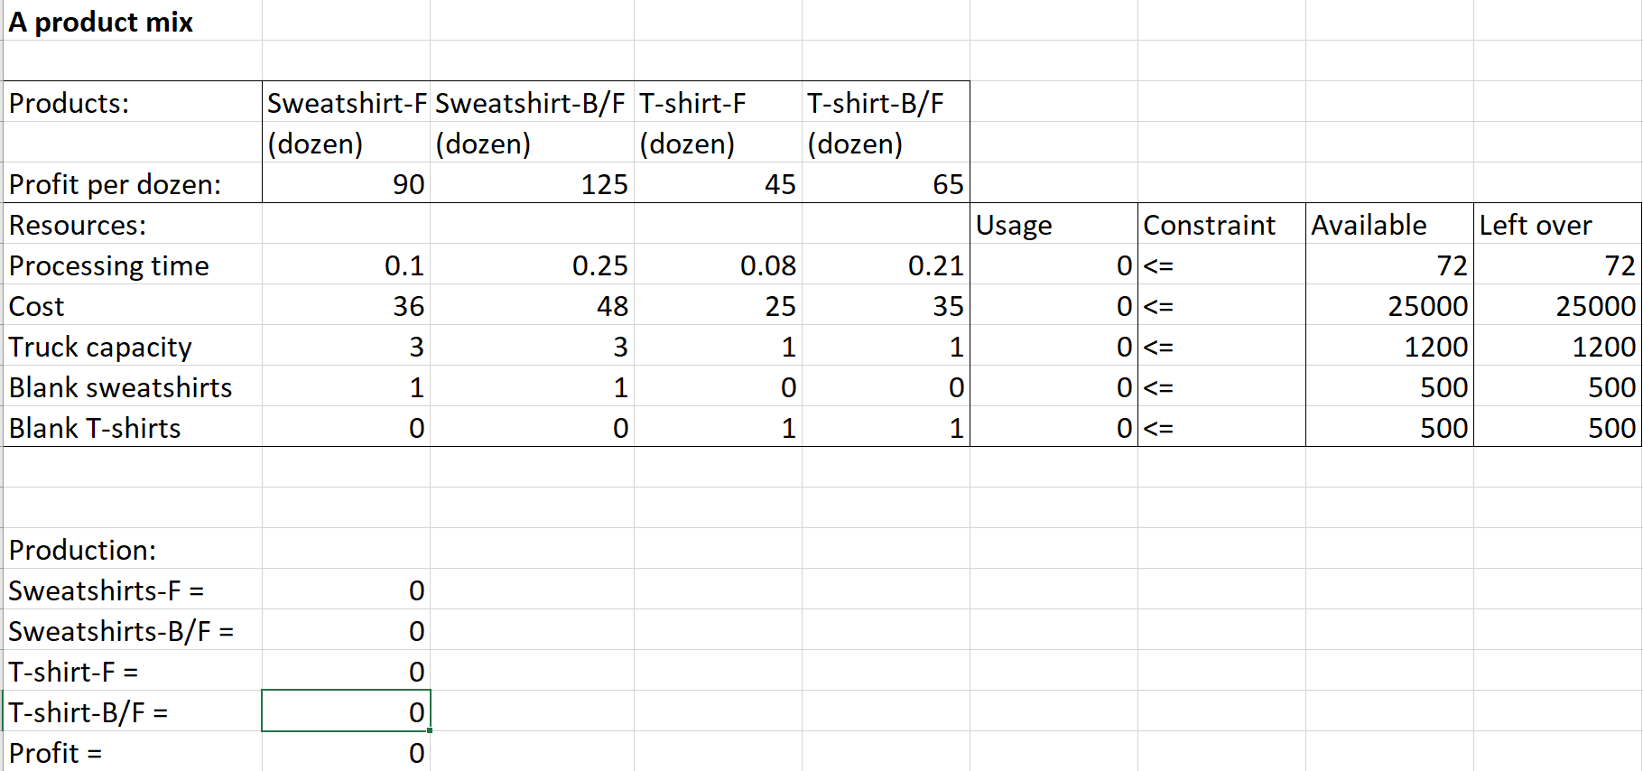
Ex: Quick-Screen Clothing
Download ProductMix.xlsx from website link called Sheet 2
Before Excel solver

Slide 18
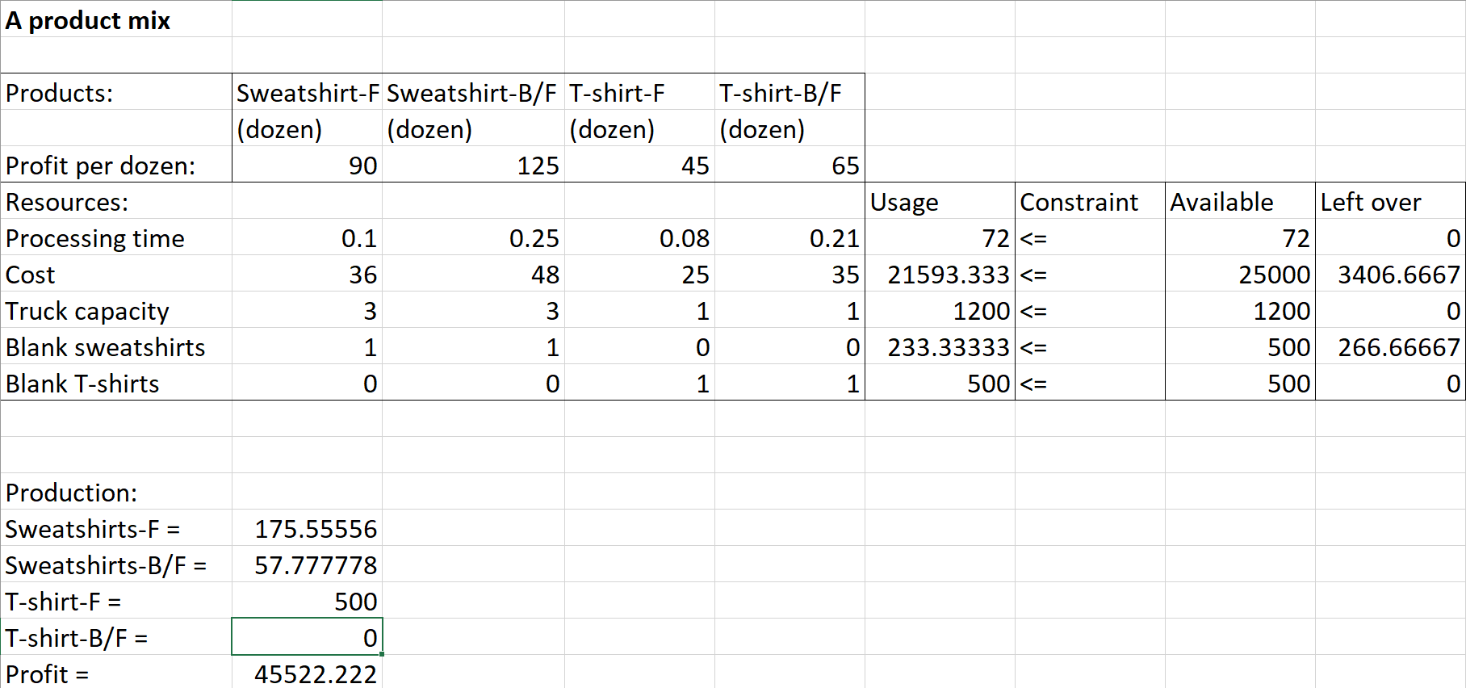
Ex: Quick-Screen Clothing
After Excel solver

Slide 19
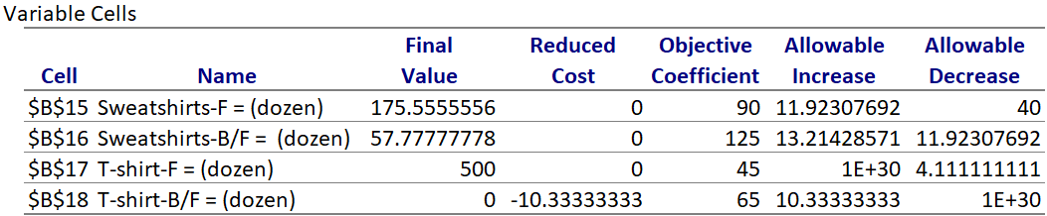
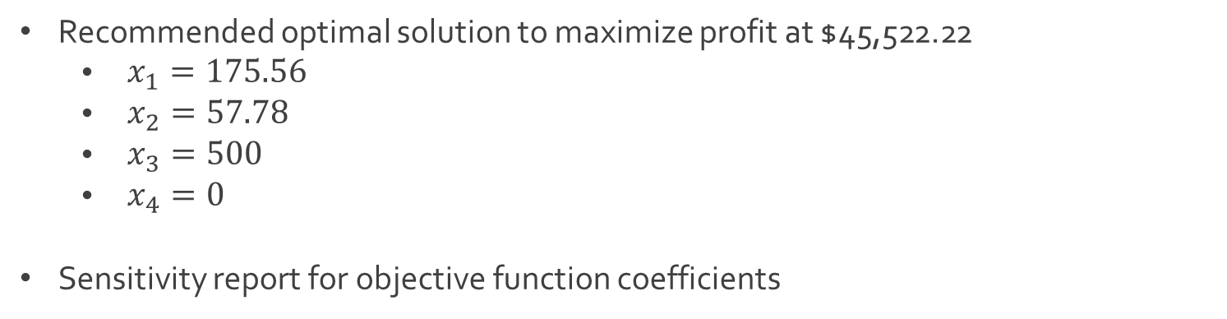
Ex: Quick-Screen Clothing
Recommended optimal solution to maximize profit at $45,522.22
$\begin{aligned} x_{1}=175.56\end{aligned}$
$\begin{aligned} x_{2}=57.78\end{aligned}$
$\begin{aligned} x_{3}=500\end{aligned}$
$\begin{aligned} x_{4}=0\end{aligned}$
Sensitivity report for objective function coefficients

Slide 20
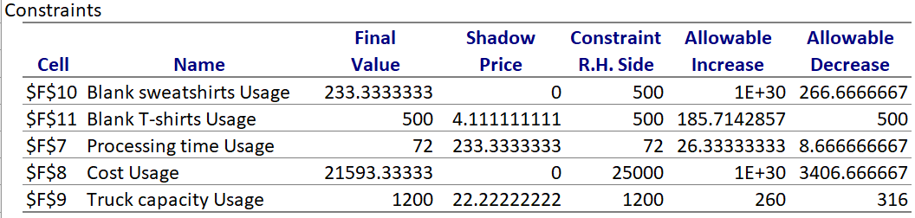
Ex: Quick-Screen Clothing
Sensitivity report for constraint quantities

Slide 21




The End
Dale

